Slide 1

Sales Price Prediction using Machine Learning
Predicting sales price using machine learning can be valuable for businesses seeking to optimize pricing strategies and improve forecasting accuracy. This presentation explores a project using linear regression to predict the total price of a product based on multiple input features, including beverage category, product category, customer category, region, unit price, quantity, and discount. The project also leverages Streamlit to create a user-friendly web application for real-time predictions.

Slide 2
Project Overview
Goal
Method
Deployment
Predict the total price of a product using machine learning.
Linear Regression trained on a dataset of beverage sales.
Streamlit web application for user interaction and real-time prediction.

Slide 3
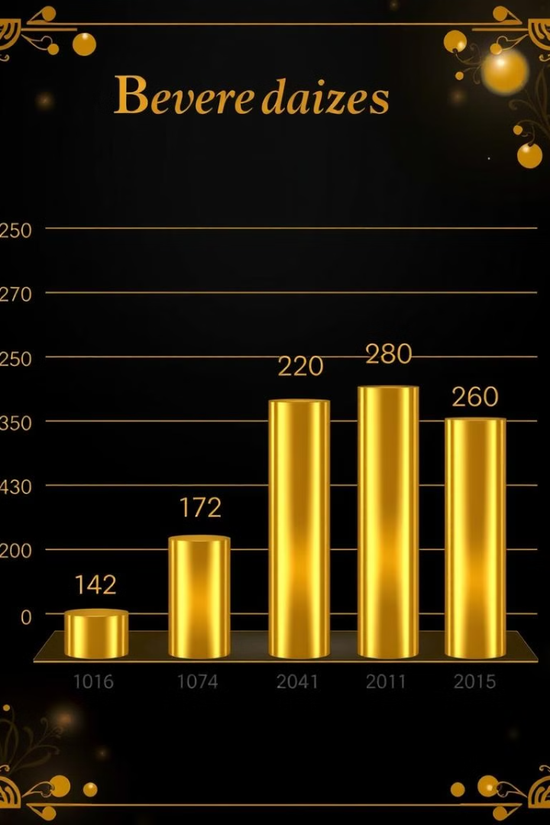
Feature Engineering
Beverage Category
Categorical variable describing the type of beverage.
Product Category
Categorical variable describing the specific product within the beverage category.
Customer Category
Categorical variable describing the type of customer making the purchase.
Region
Categorical variable indicating the geographical region of the sale.

Slide 4
Numerical Features
Unit Price
Quantity
Discount
Numerical value representing the cost per unit of the product.
Numerical value indicating the number of units purchased.
Numerical value representing the percentage of discount applied to the purchase.

Slide 5
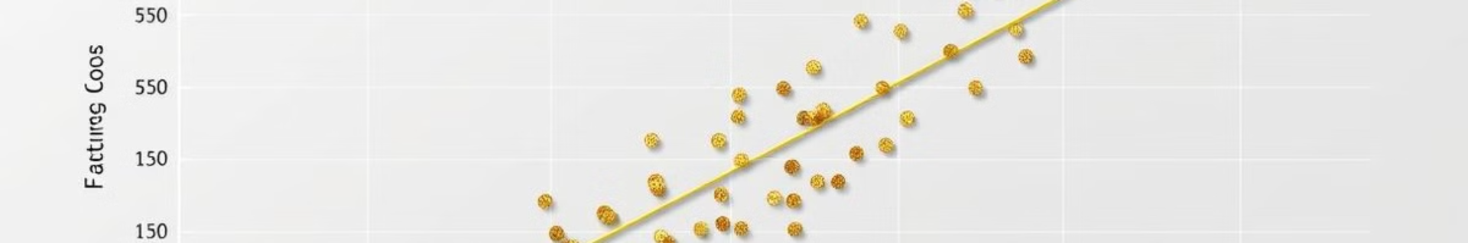
Model Training and Evaluation
Data Preprocessing
Model Training
Transform categorical features into numerical representation using one-hot encoding.
Train the linear regression model using the scikit-learn library.
1
2
3
4
Data Splitting
Model Evaluation
Divide the dataset into training and testing sets for model training and evaluation.
Evaluate the model's performance using metrics such as Mean Squared Error (MSE) and R² Score.

Slide 6
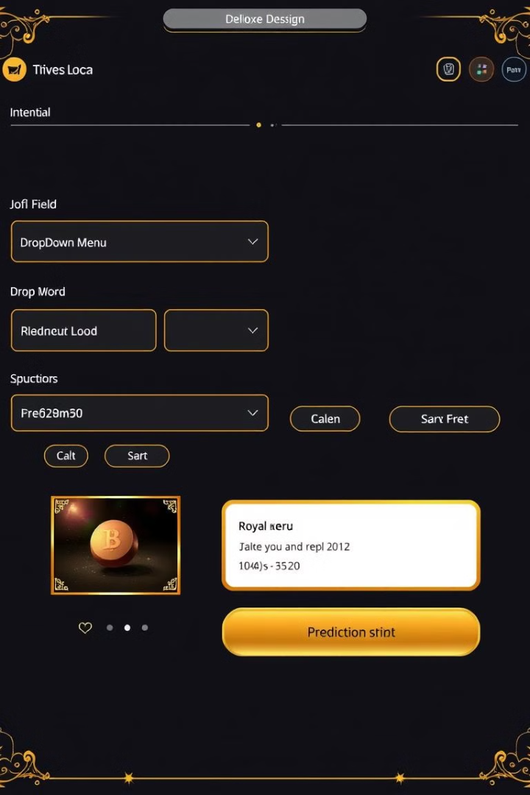



Streamlit Web Application
Allows users to input product details.
Generates a real-time price prediction based on user input.
Visualizes the prediction result for better understanding.

Slide 7

Future Improvements
1
Hyperparameter Tuning
2
Multiple Regression Models
Optimize model performance by adjusting hyperparameters for better accuracy.
Explore and implement different regression models such as Random Forest or Gradient Boosting.
3
Deployment
Deploy the model to a cloud platform or Docker container for wider accessibility and scalability.

Slide 8
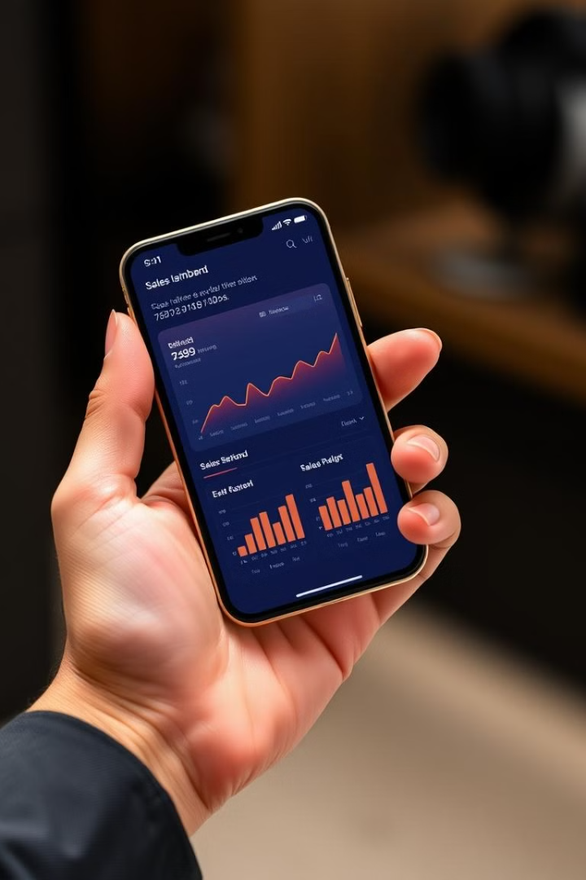
Key Takeaways
This project demonstrates the practical application of machine learning in predicting sales price using linear regression and Streamlit. The web application provides a user-friendly interface for real-time predictions, making it a valuable tool for businesses. Future improvements include exploring advanced regression models, implementing hyperparameter tuning, and deploying the model for wider accessibility.

